Slide 1
All about me !!!
By:Amiranys
Urbano

Slide 2
My favorite team is:
Alabama Roll Tide !!!!!

Slide 3
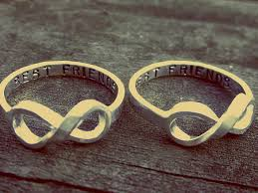
My best friends are:
Kimber Davis
Sabrina Mann
Taylor Jenkins
Alana Tatum
Ashanti Williams

Slide 4
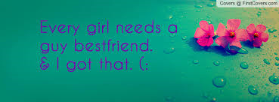
My friends that are boys are..
KEVIN
ELI
JONATHAN

Slide 5
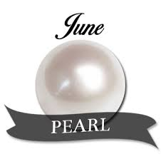
My birthday is on June 4 , 2003

Slide 6
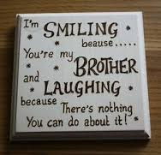
I only have one brother
His name is jhony Urbano.

Slide 7
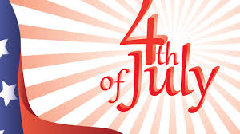
My favorite Holiday Is
4th of july

Slide 8
My favorite animal
Is a
dolphin

Slide 9
One thing about
Me is that I am 12 .

Slide 10
My favorite color is
Blue

Slide 11
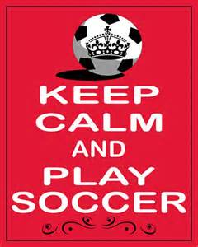
My favorite sport is
Soccer

Slide 12
M y favorite subject is..
Social
Studies

Slide 13
My favorite hobby
Is to read

Slide 14
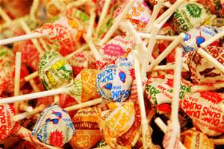
My favorite candy is..
LOLLPOPS

Slide 15
My favorite T.V show is
Walking dead

Slide 16
One place I want to go is
Mexico

Slide 17
My favorite time of the day is ..
When it’s time for 4th period which is P.E.

Slide 18
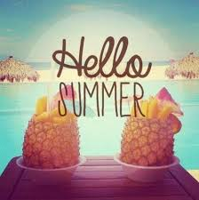
My favorite season is
Summer

Slide 19
What I like about school is
THE TEACHERS AND THE WAY THEY TEACH

Slide 20
the End
That’s all about me

